Slide 1

Predictive Analytics Using SAS
Marketing Analytics Team 4

Slide 2
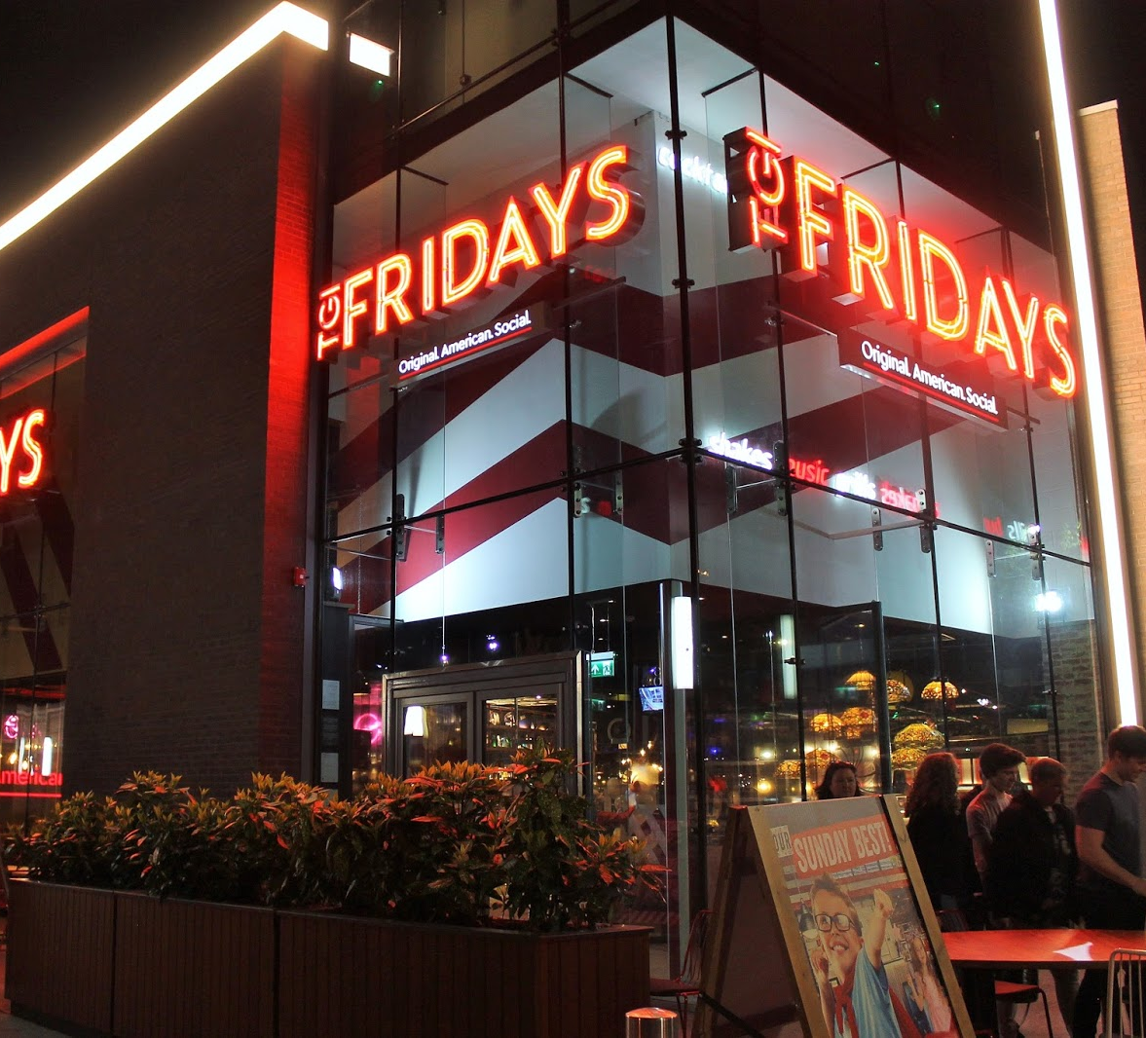
AGENDA
Executive Summary
Analytic Techniques
Segmentation Overview
Segmentation Analysis
Financial Implication
Test and Learn Plan

Slide 3

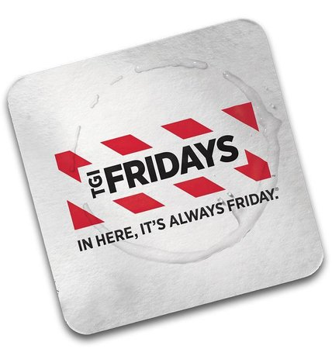
Executive Summary
The Company:
TGI Fridays is an American restaurant chain focusing on casual dining.
TGIF stands for Thank God Its Friday.
It has over 900 restaurants in 60 countries.
The Objective:
To increase revenue by applying marketing analytics techniques to the sales data.
Financial Impact:
Increasing the price by 20% and applying recommendations would increase revenue by $233,254.87 or 13.5%.

Slide 4
Techniques
Elasticity Modelling:
Which cluster is price sensitive/insensitive? How can changes in pricing increase total revenue.
Market Basket:
Which products go well together? How to bundle different products to increase sales.
OLS:
What marcom and discount actions should TGIF do to increase margins.

Slide 5
Segmentation Overview
Faithful Frequents
Let’s get married??
Customer Base
6%
Special Occasioners
The annoying relatives!
Customer Base
13%
Bar Patrons
Not Drunk Enough!
Customer Base
22%
Total Revenue
20%
Sweet Discounters
No Strings Attached!
Customer Base
11%
Family Lunches
Dad! I want more Cake!
Customer Base
23%
Point Accumulators
Bring me yon food!
Customer Base
24%
Total Revenue
17%
Total Revenue
21%
Total Revenue
29%
Total Revenue
7%
Total Revenue
7%

Slide 6
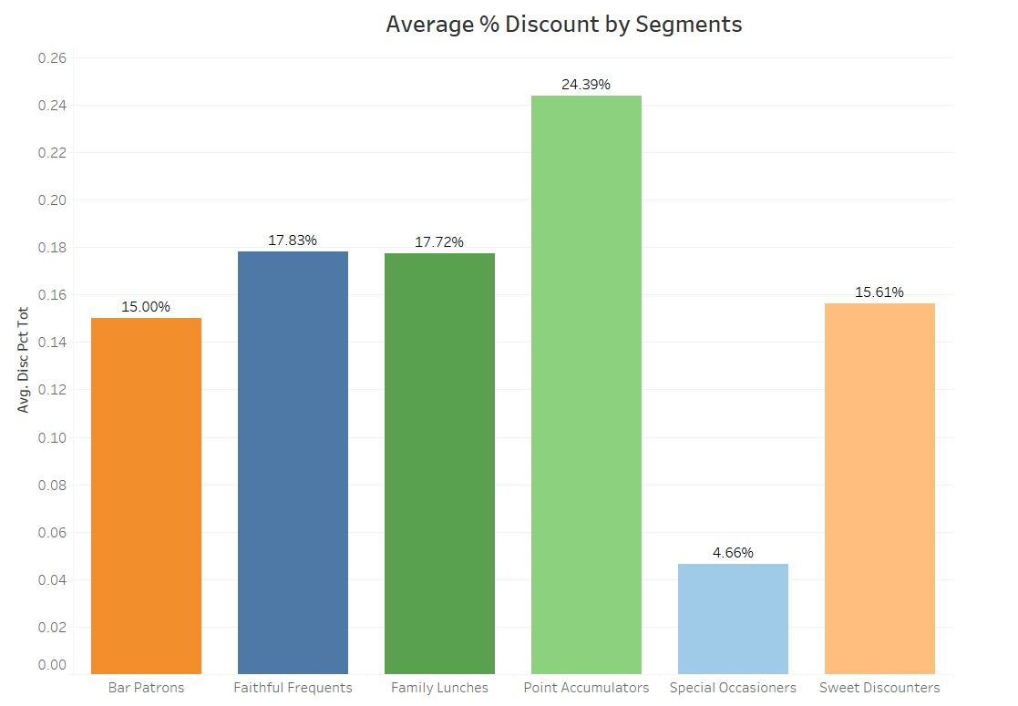
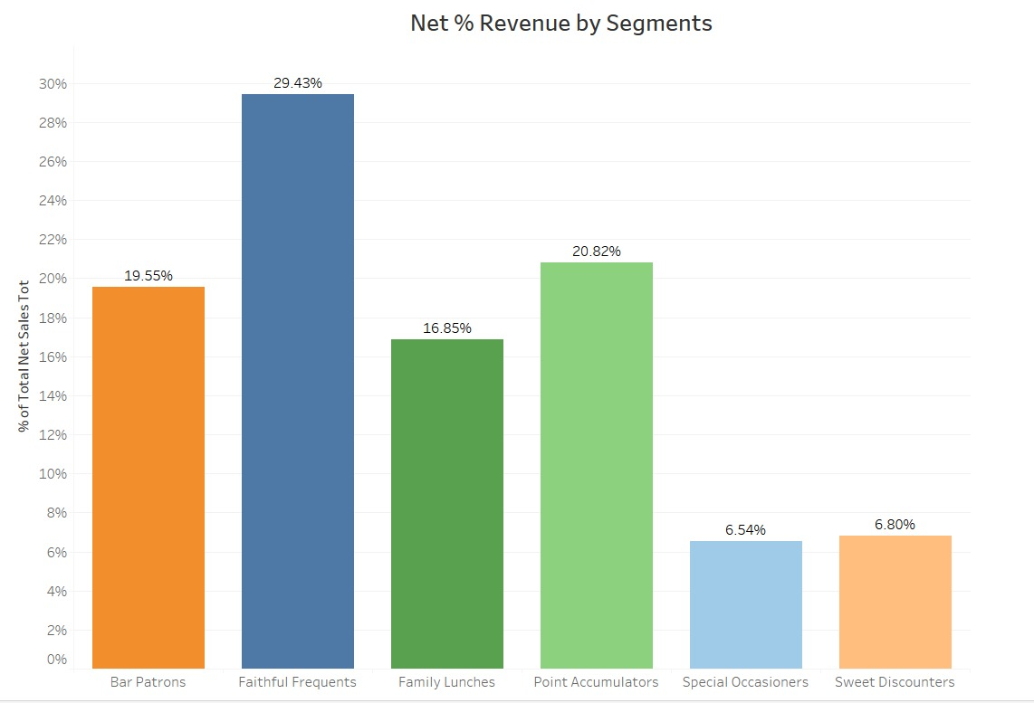
Segmentation Overview

Slide 7
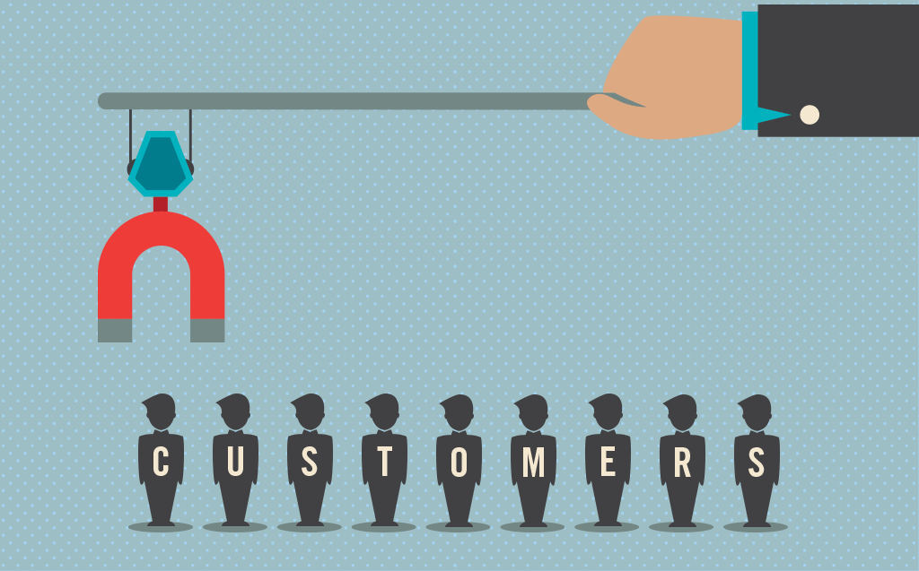
Faithful Frequents
Smallest segment but largest net revenue (29% revenue).
They get good discounts (17%).
Largest % Loyalty member group
Respond well to emails sent.
Average days between visits, 17 days (key driver)
3Xs higher than the average attendance in last 12 months

Slide 8

Faithful Frequents – Strategy
Insensitive to price:
Increasing the price by 20% will increase the revenue by 13%.
Incremental change +$68,569.
To Bundle:
Alcohol + Appetizer will increase the probability of buying appetizers by 773%.
Kids food + beverage will increase the probability of buying beverage by 888%.
Do not Bundle:
Alcohol + Beverage will decrease the probability of buying beverages by 79%.
Appetizers + Entrees will decrease the probability of buying entrees by 100%.

Slide 9
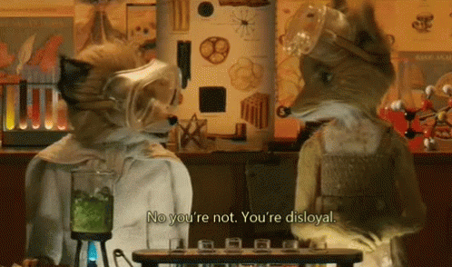
Special Occasioners
Our lowest total spenders.
Get least discounts and have least point ratios.
Have below average email send an opening rate.
61% of customers visit during dinner hours.
Are highest when it comes to breakfast and takeout.
Largest amount per item group (date nights?)
Average days between visits, 22 days

Slide 10
Special Occasioners – Strategy
Insensitive to price:
Increasing the price by 20% will increase the revenue by 3.7%.
Incremental change +$4,093.
Target customers to join Fridays loyalty program
OLS shows a +$11.20 increase in spend for members vs non members.
Incremental change +$15,266.
To Bundle:
Beverage + Appetizers will increase the probability of buying Appetizers by 222%.
Kids food + Appetizers will increase the probability of buying Appetizers by 152%.
Do not Bundle:
Appetizer + Steak will decrease the probability of buying steak by 64%.
Soup + steak will decrease the probability of buying steak by 37%.

Slide 11
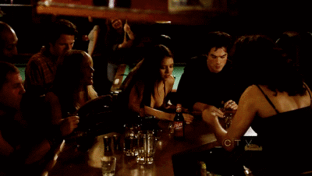
Bar Patrons
Has high potential for increasing revenue.
22% of customer base is generating 20% of revenues.
75% of the time they are at the bar (hence the name) and rarely order food
Around 30% visit for lunch and 64% for dinner.
Average days between visits, 34 days

Slide 12
Bar Patrons – Strategy
Slightly Insensitive to price:
Give 8% discount. This will increase the revenue by 5%.
Incremental change +$17,616.
Send more email!! If email open rate increases by 1%, then total sales will increase by 5.6%.
Incremental change +$18,210.
Target customers to join Fridays loyalty program
OLS shows a +$11.20 increase in spend for members vs non members
Incremental change +$15,165.
To Bundle:
Alcohol + Appetizer will increase the probability of buying appetizer by 280%.
Do not Bundle:
Beverage + Alcohol will decrease the probability of buying alcohol by 66%.

Slide 13
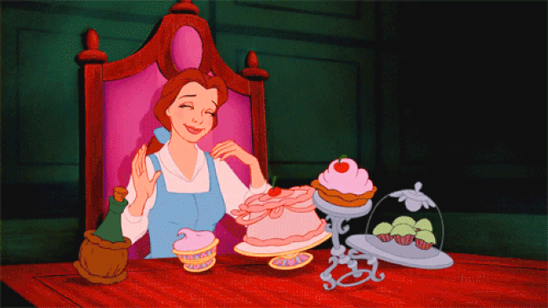
Sweet Discounters
They get “sweet” discounts.
66% of customers visit for dinner but order dessert.
Strong response on emails sent
Average days between visits, 29 days

Slide 14
Sweet Discounters – Strategy
Insensitive to price:
Increasing the price by 20% will increase the revenue by 5.4%.
Incremental change +$6,369.
Target customers to join Fridays loyalty program
OLS shows a +$11.20 increase in spend for members vs non members
Incremental change +$7,806
To Bundle:
Desert + Appetizer will increase the probability of buying Appetizer by 230%.
Dessert + Kids food will increase the probability of buying Kids food by 520%.
Do not Bundle:
Dessert + Burger will decrease the probability of buying Burger by 98%.
Burger + steak will decrease the probability of buying steak by 33%.

Slide 15
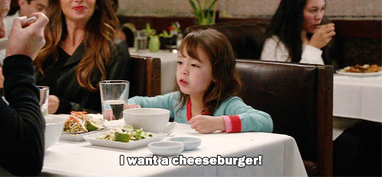
Family Lunches
Receive 5% higher discount than average.
66% of customers visit during lunch hours.
Even mix of discount channel distribution
Average days between visits, 35 days

Slide 16
Family Lunches – Strategy
Insensitive to price:
Increasing the price by 20% will increase the revenue by 7.1%.
Giving Bogo offers on kids food will increase sales by 1.7%.
Incremental change +$25,644.
Target customers to join Fridays loyalty program
OLS shows a +$11.20 increase in spend for members vs non members
Incremental change +$16,901
To Bundle:
Beverage + Steak will increase the probability of buying Steak by 180%.
Entrees + Desserts food will increase the probability of buying Deserts by 146%.
Kid’s food + Dessert will increase the probability of buying Kid’s food by 144%.
Do not Bundle:
Kids + Soup will decrease the probability of buying soup by 37%.

Slide 17
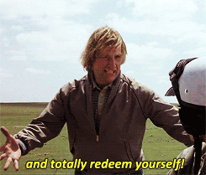
Point Accumulators
Have highest discount rate due to redeeming high total points at limited number of visits.
Higher appearance at lunch or late night compared to other segments.
Has the highest average days between visits – 36!!!

Slide 18
Point Accumulators – Strategy
Insensitive to price:
Increasing the price by 20% will increase the revenue by 6.1%.
Incremental change +$22,373.
Target customers to join Fridays loyalty program
OLS shows a +$11.20 increase in spend for members vs non members
Incremental change +$15,243
To Bundle:
Appetizer + Kids food will increase the probability of buying Kids food by 123%.
Beverage + Entrees will increase the probability of buying Entrees by 125%.
Do not Bundle:
Alcohol + beverage will decrease the probability of buying beverage by 46%.

Slide 19
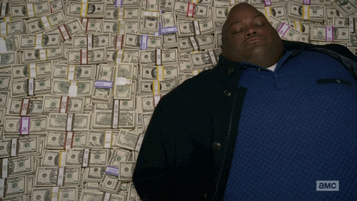
Financial Implication
 | Current Revenue | Incremental | Predicted Revenue | % Revenue Increase
Faithful Frequents | $ 516,884.57 | $ 68,569.29 | $ 585,453.86 | 13%
Special Occasioners | $ 110,544.77 | $ 19,358.43 | $ 129,903.30 | 18%
Bar Patrons | $ 325,171.21 | $ 50,990.29 | $ 376,161.50 | 16%
Sweet Discounters | $ 118,019.94 | $ 14,175.68 | $ 132,195.62 | 12%
Family Lunches | $ 292,833.93 | $ 42,544.54 | $ 335,378.47 | 15%
Point Accumulators | $ 364,383.75 | $ 37,616.64 | $ 402,000.39 | 10%
Total | $ 1,727,838.17 | $ 233,254.87 | $ 1,961,093.04 | 13%

Slide 20

Test it Out
Begin to apply the recommended strategies on a limited number of stores.
Monitor data closely and if results look positive, apply strategy to an additional 20% of the stores and continue to monitor results.
Additionally, we recommend reducing the amount of time to redeem reward certificates from 60 days to 30 days in an effort to reduce the amount of days in between visits. Test this in several locations and monitor customer reviews.
If all test above prove to be successful then roll out nationwide.

Slide 21
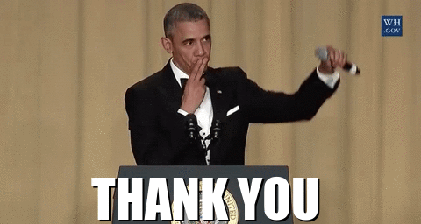
Marketing Team 4:
Chaturvedi Musham
Jason Alley
Priyanshu Srivatsava
Utkarsh Raj Pandey
Shengjing Feng

